Slide 1
Bandwidth Utilization:
Multiplexing
Lecture-11
Chapter 06

Slide 2
Topics to be discussed
Multiplexing
Frequency Division Multiplexing (FDM)
Wave Division Multiplexing (WDM)
Time Division Multiplexing (TDM)

Slide 3
Bandwidth Utilization
Wise use of available bandwidth to achieve specific goals(efficiency and security).
Techniques: multiplexing, spreading
Efficiency can be achieved by multiplexing.
Privacy and anti-jamming can be achieved by spreading.

Slide 4
MULTIPLEXING
Multiplexing allows simultaneous transmission of multiple signals across a single data link.
Communication is possible over the air (radio frequency), using a physical media (cable), and light (optical fiber).
All mediums are capable of multiplexing.

Slide 5
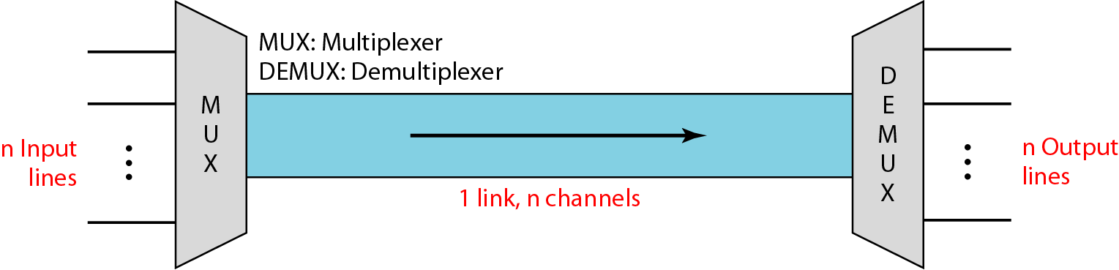
Figure 6.1 Dividing a link into channels

Slide 6
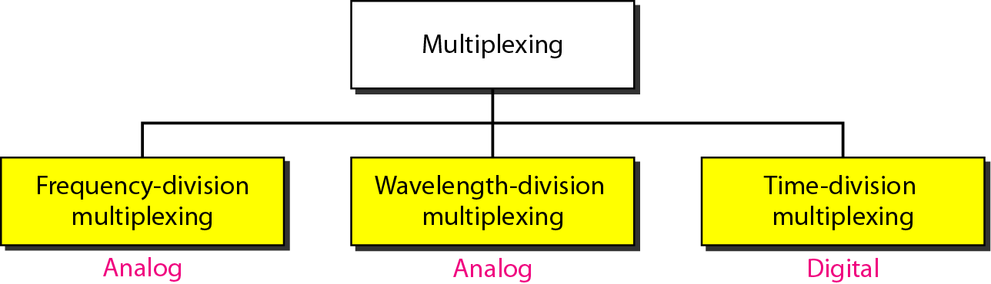
Figure 6.2 Categories of multiplexing

Slide 7
MULTIPLEXING TECHNIQUES
Frequency-Division Multiplexing
Wave length -Division Multiplexing
Time Division Multiplexing
Synchronous Time-Division Multiplexing
Statistical Time-Division Multiplexing
Code Division Multiplexing

Slide 8
Frequency Division Multiplexing ( FDM)
FDM divides the spectrum in to multiple channels and allocates one user to each channel.
Each user can use the channel frequency independently and has exclusive access of it.
All channels are divided in such a way that they do not overlap with each other.
Channels are separated by guard bands.
Guard band is a frequency which is not used by either channel.

Slide 9
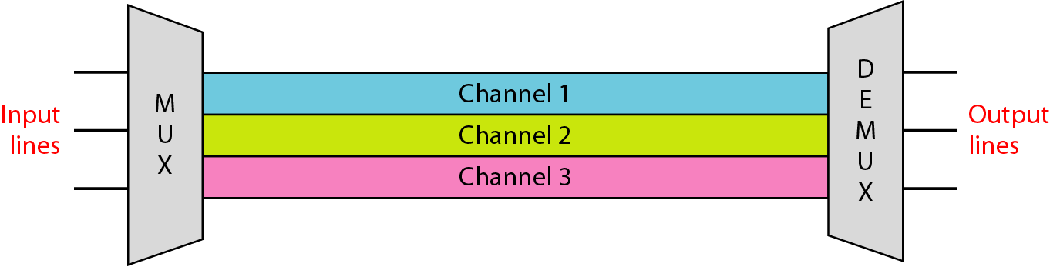
Frequency-division multiplexing
f1
f2
f3
FDM is an analog multiplexing technique that combines analog signals.

Slide 10
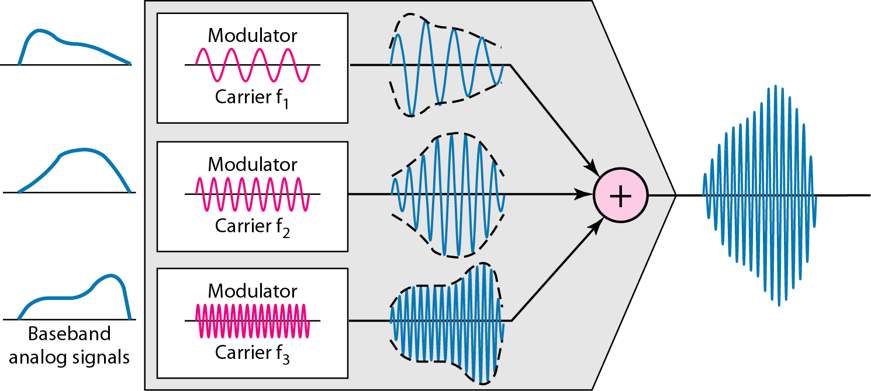
Figure 6.4 FDM process

Slide 11
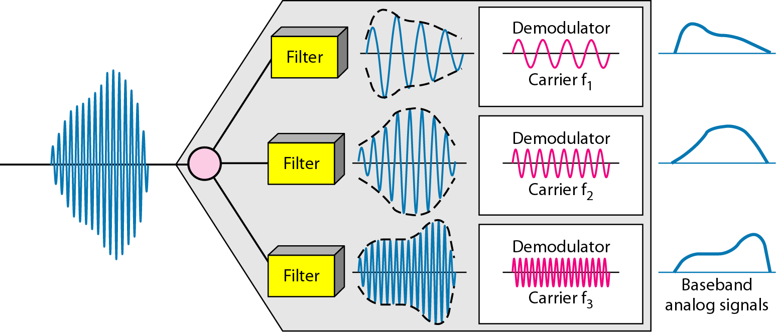
Figure 6.5 FDM demultiplexing example

Slide 12
Example 6.1
Assume that a voice channel occupies a bandwidth of 4 kHz. We need to combine three voice channels into a link with a bandwidth of 12 kHz, from 20 to 32 kHz. Show the configuration, using the frequency domain. Assume there are no guard bands.
Solution
We shift (modulate) each of the three voice channels to a different bandwidth, as shown in Figure 6.6. We use the 20- to 24-kHz bandwidth for the first channel, the 24- to 28-kHz bandwidth for the second channel, and the 28- to 32-kHz bandwidth for the third one. Then we combine them as shown in Figure 6.6.

Slide 13
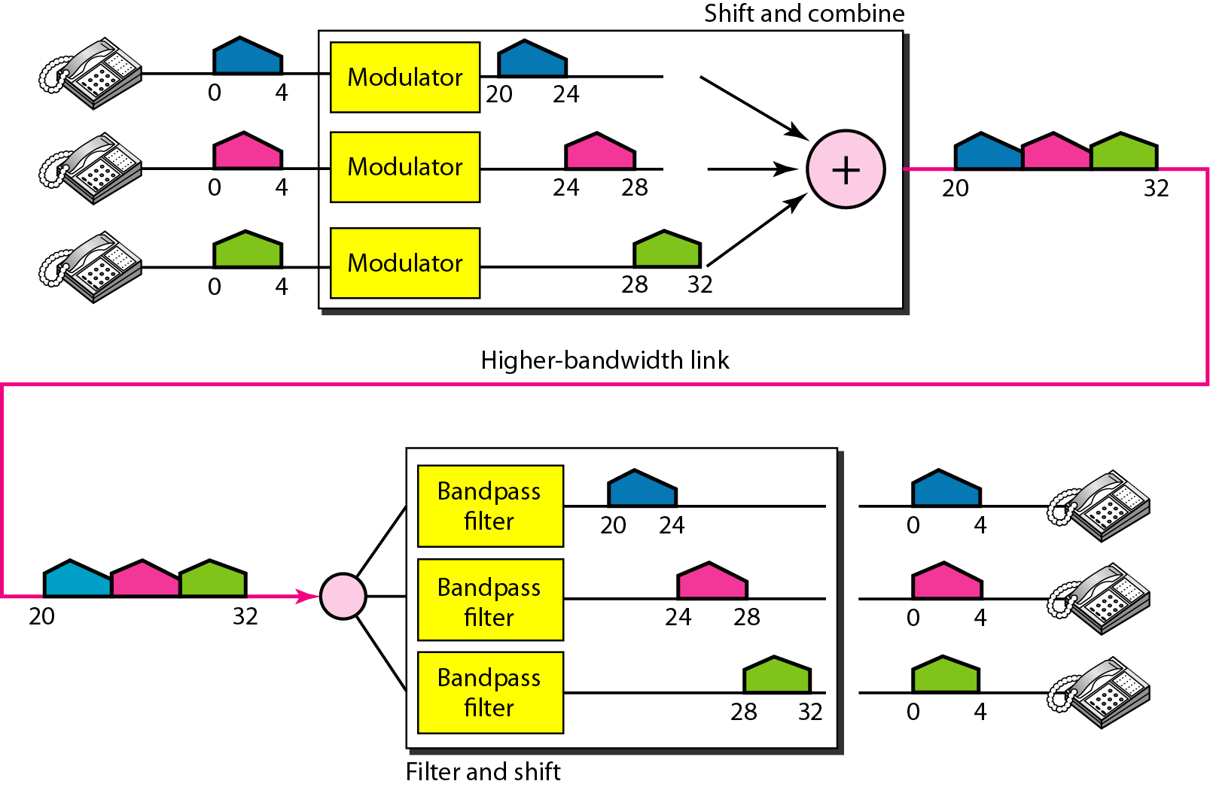
Figure 6.6 Example 6.1

Slide 14
Example 6.2
Five channels, each with a 100-kHz bandwidth, are to be multiplexed together. What is the minimum bandwidth of the link if there is a need for a guard band of 10 kHz between the channels to prevent interference?
Solution
For five channels, we need at least four guard bands. This means that the required bandwidth is at least
5 × 100 + 4 × 10 = 540 kHz,
as shown in Figure 6.7.

Slide 15
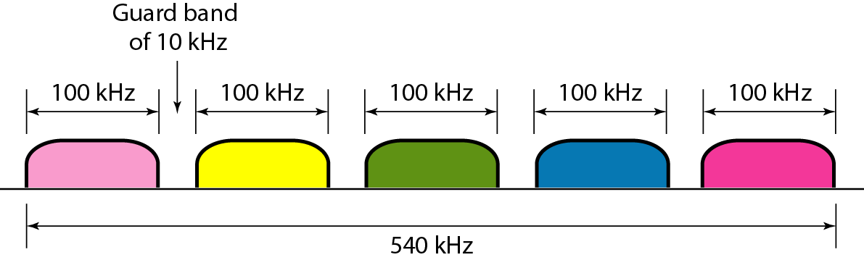
Figure 6.7 Example 6.2

Slide 16
Wavelength Division Multiplexing
Wavelength-division multiplexing (WDM) is a technology which multiplexes a number of optical carrier signals onto a single optical fiber by using different wavelengths (i.e., colors) of laser light.
WDM enables bidirectional communications over fiber optic cable.
One application of WDM is the SONET network in which multiple optical fiber lines are multiplexed and demultiplexed.

Slide 17
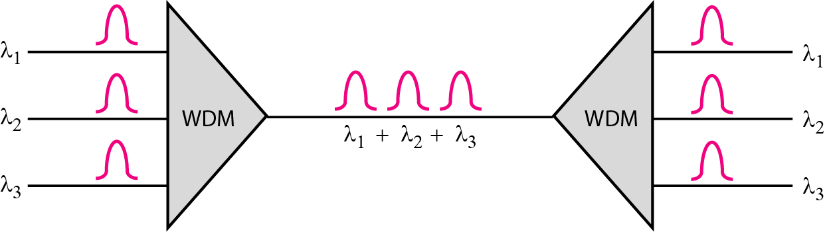
Figure 6.10 Wavelength-division multiplexing
WDM is an analog multiplexing technique to combine optical signals.

Slide 18
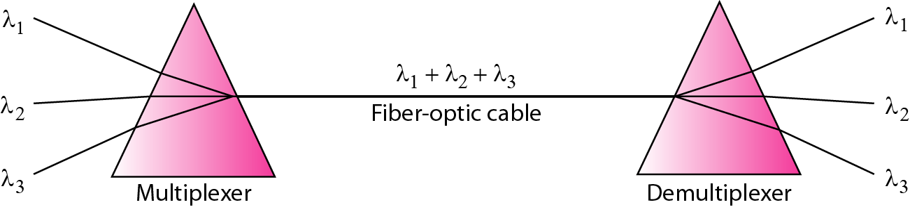
Figure 6.11 Prisms in wavelength-division multiplexing and demultiplexing

Slide 19
Time Division Multiplexing(TDM)
In TDM the shared channel is divided among its user by means of time slot.
Each user can transmit data within the provided time slot only.
Digital signals are divided in frames, equivalent to time slot i.e. frame of an optimal size which can be transmitted in given time slot.
TDM is applied on digital signals.

Slide 20
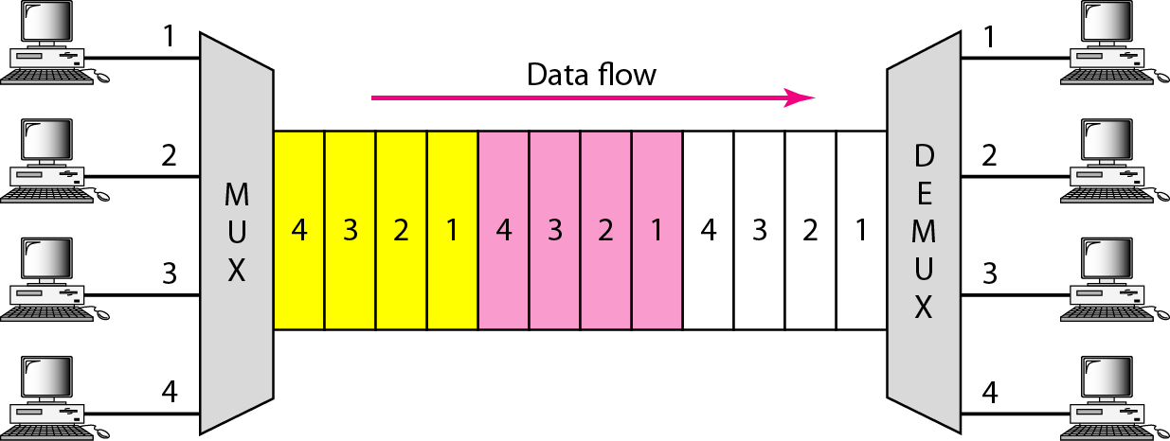
Figure 6.12 TDM
TDM is a digital multiplexing technique for combining several low-rate channels into one high-rate one.

Slide 21
Synchronous time-division multiplexing
In synchronous TDM, a round of data units from each input connection is collected into a frame.
If we have n connections, a frame is divided into n time slots and one slot is allocated for each input line.
If the duration of the input unit is T, the duration of each slot is T/n.

Slide 22
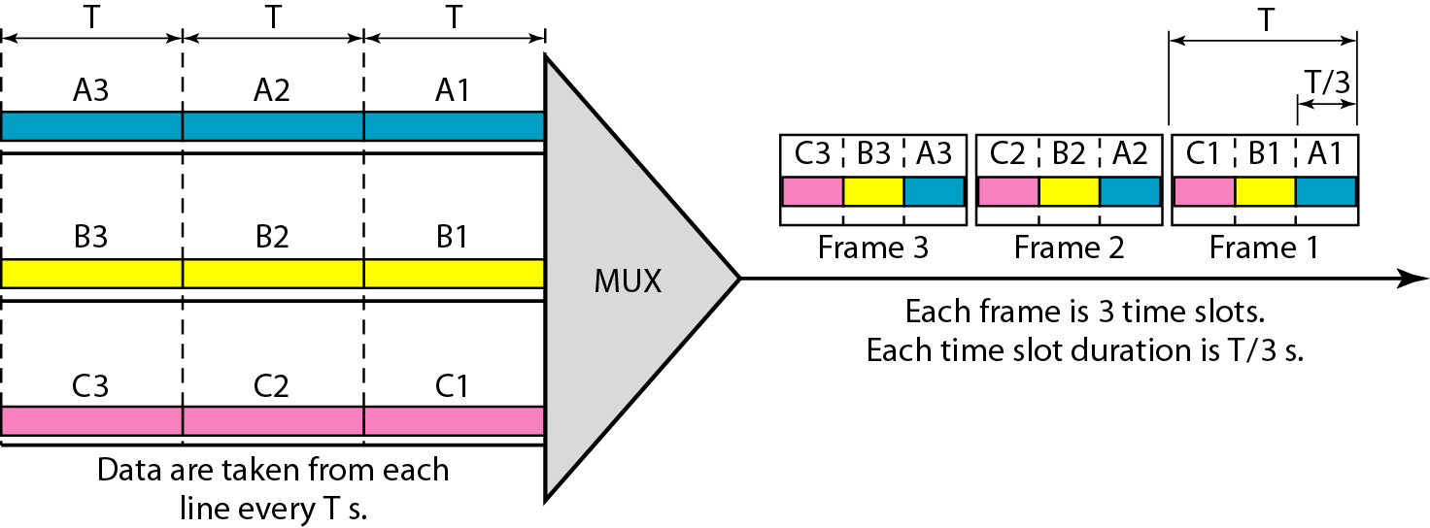
Figure 6.13 Synchronous time-division multiplexing
In synchronous TDM, the data rate of the link is n times faster, and the unit duration is n times shorter.

Slide 23
Interleaving
TDM can be visualized as two fast-rotating switches, one on the multiplexing side and the other on the demultiplexing side.
The switches are synchronized and rotate at the same speed, but in opposite directions.
On the multiplexing side, as the switch opens in front of a connection, that connection has the opportunity to send a unit onto the path.
On the demultiplexing side, as the switch opens in front of a connection, that connection has the opportunity to receive a unit from the path.
This process is called interleaving.

Slide 24
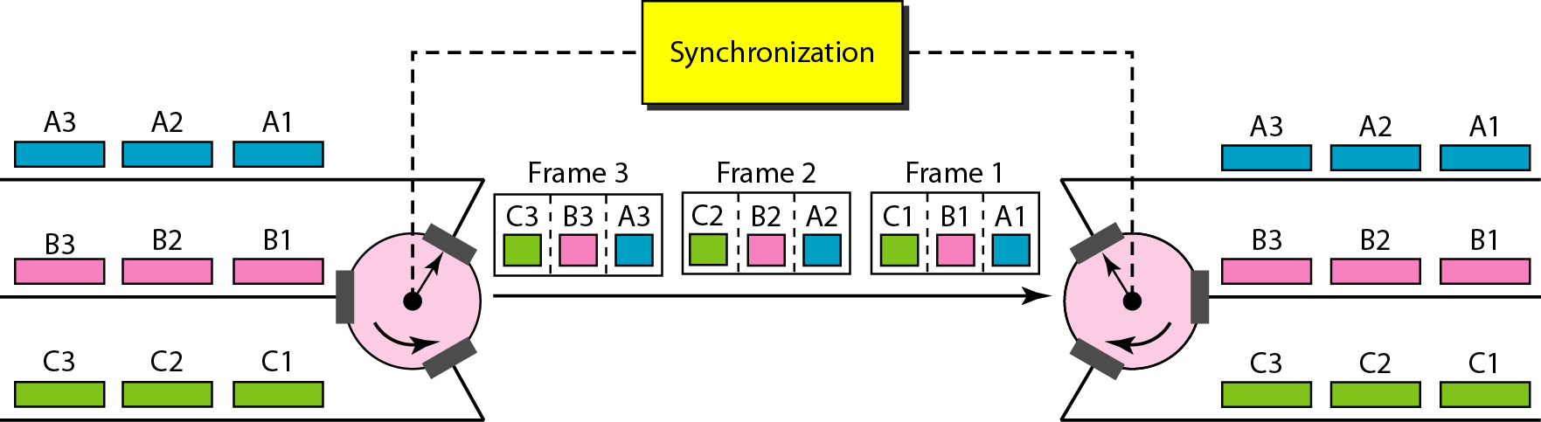
Figure 6.15 Interleaving

Slide 25
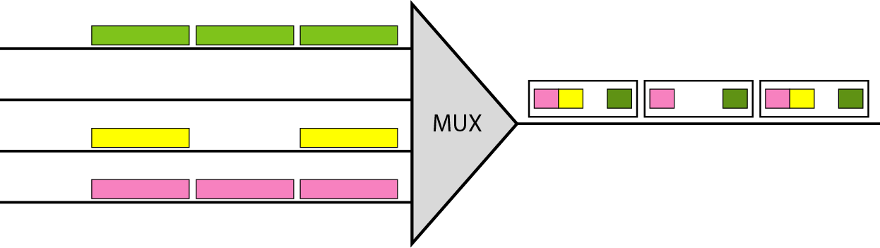
Empty slots
Synchronous TDM is not as efficient as it could be. If a source does not have data to send, the corresponding slot in the output frame is empty.

Slide 26
Data Rate Management
If data rates of input lines are not the same, three strategies, or a combination of them, can be used to manage the data rate.
multilevel multiplexing
multiple-slot allocation
pulse stuffing

Slide 27
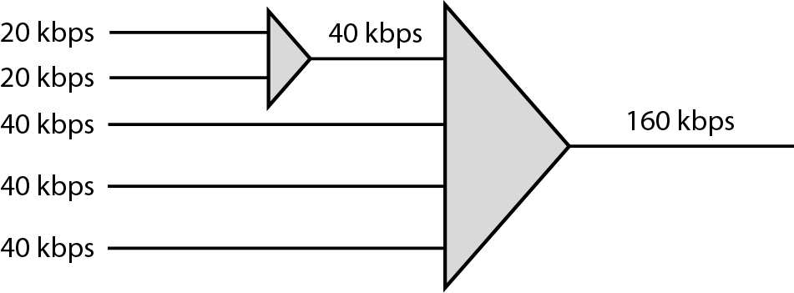
1. Multilevel multiplexing
Multilevel multiplexing is a technique used when the data rate of an input line is a multiple of others.

Slide 28
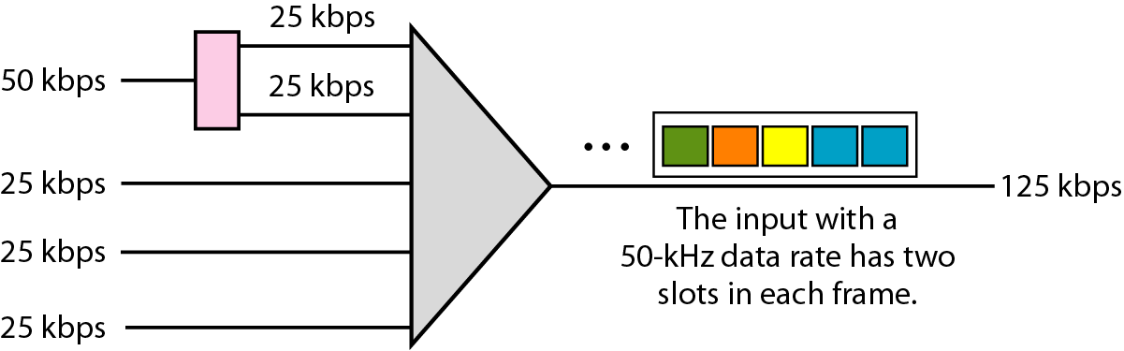
2. Multiple-slot multiplexing
Allot more than one slot in a frame to a single input line.

Slide 29
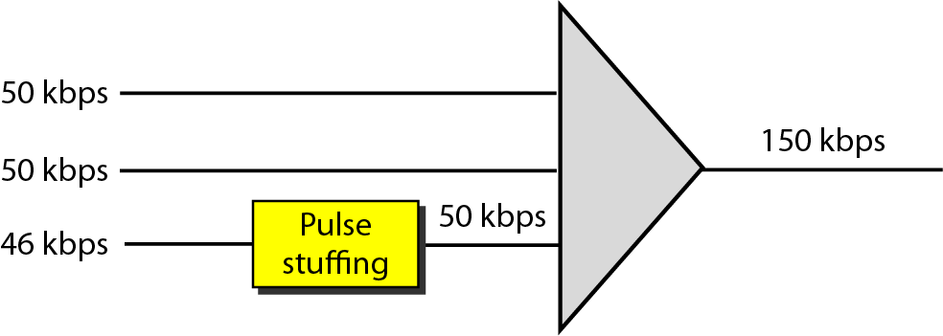
3. Pulse stuffing
Sometimes the bit rates of sources are not multiple integers of each other. previous method can not be used.
One solution is to make the highest input data rate the dominant data rate and then add dummy bits to the input lines with lower rates.

Slide 30
Frame Synchronizing
Synchronization between the multiplexer and demultiplexer is a major issue.
If the multiplexer and the demultiplexer are not synchronized, a bit belonging to one channel may be received by the wrong channel.
For this reason, one or more synchronization bits are usually added to the beginning of each frame.
These bits, called framing bits, follow a pattern, frame to frame, that allows the demultiplexer to synchronize with the incoming stream so that it can separate the time slots accurately.

Slide 31
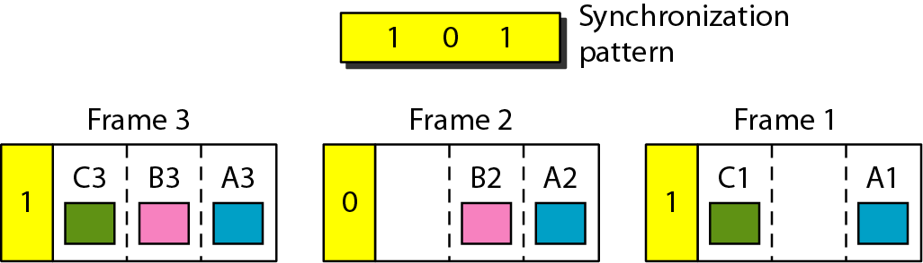
Figure 6.22 Framing bits

Slide 32
Statistical Time-Division Multiplexing
In synchronous TDM, each input has a reserved slot in the output frame. This can be inefficient if some input lines have no data to send.
In statistical time-division multiplexing, only when an input line has data to send, it is given a slot in the output frame.
In statistical multiplexing, the number of slots in each frame is less than the number of input lines.
The multiplexer checks each input line in round robin fashion; it allocates a slot for an input line if the line has data to send; otherwise, it skips the line and checks the next line.

Slide 33
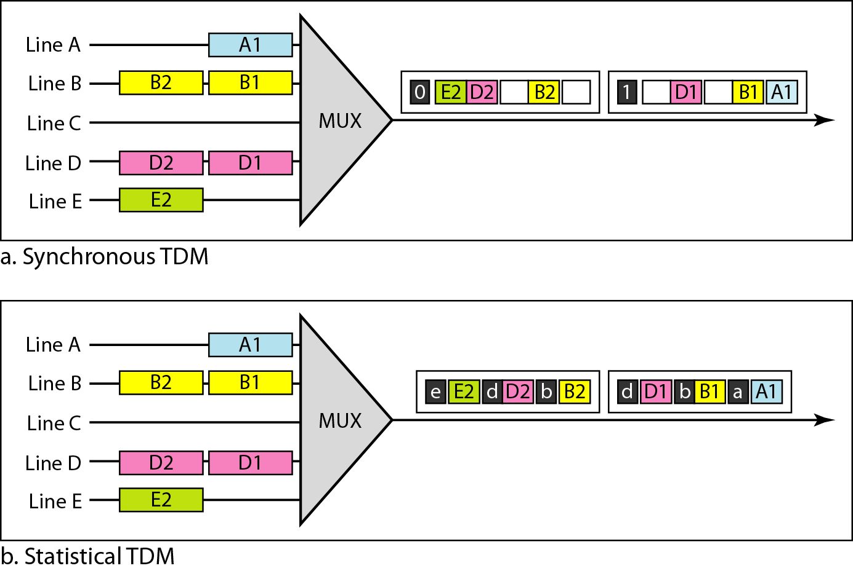
TDM slot comparison
a, b, c, d, e are addresses of the destination

Slide 34
Each channel has a unique code
All channels use the same spectrum at the same time.

Slide 35
SPREAD SPECTRUM(Code Division Multiplexing)
In spread spectrum (SS), we combine signals from different sources to fit into a larger bandwidth, but our goals are to prevent eavesdropping and jamming.
To achieve these goals, spread spectrum techniques add redundancy.
The two techniques used are:
Frequency Hopping Spread Spectrum (FHSS)
Direct Sequence Spread Spectrum Synchronous (DSSSS)

Slide 36
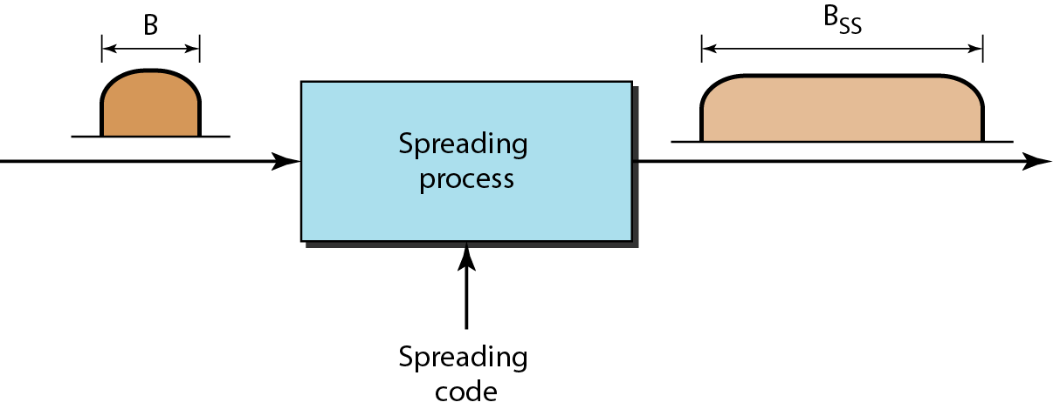
Figure 6.27 Spread spectrum

Slide 37
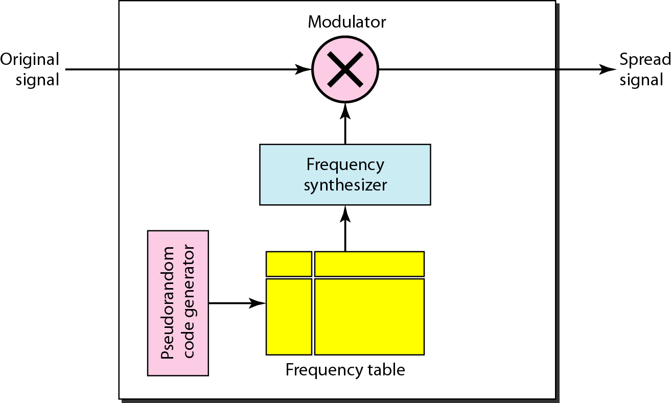
Figure 6.28 Frequency hopping spread spectrum (FHSS)
Signal is broadcast over seemingly random series of radio frequencies.
Signal hops from frequency to frequency at fixed intervals.
Channel sequence dictated by spreading code

Slide 38
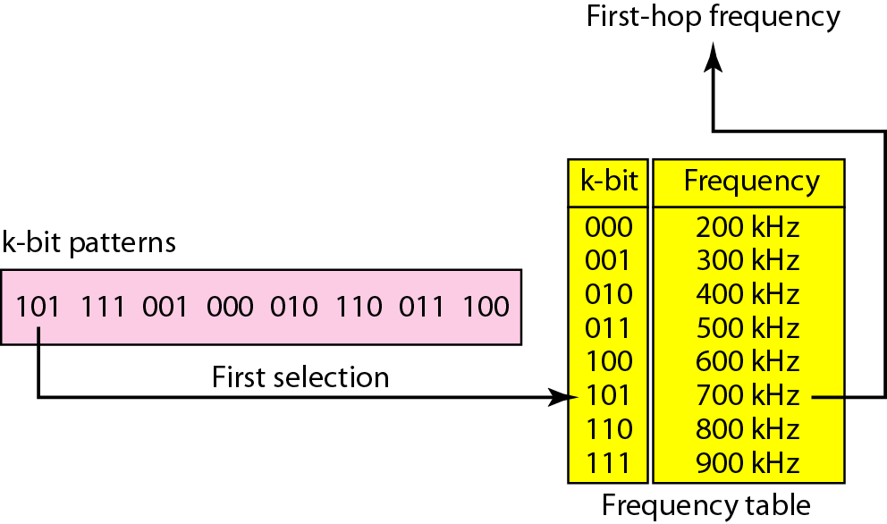
Figure 6.29 Frequency selection in FHSS

Slide 39
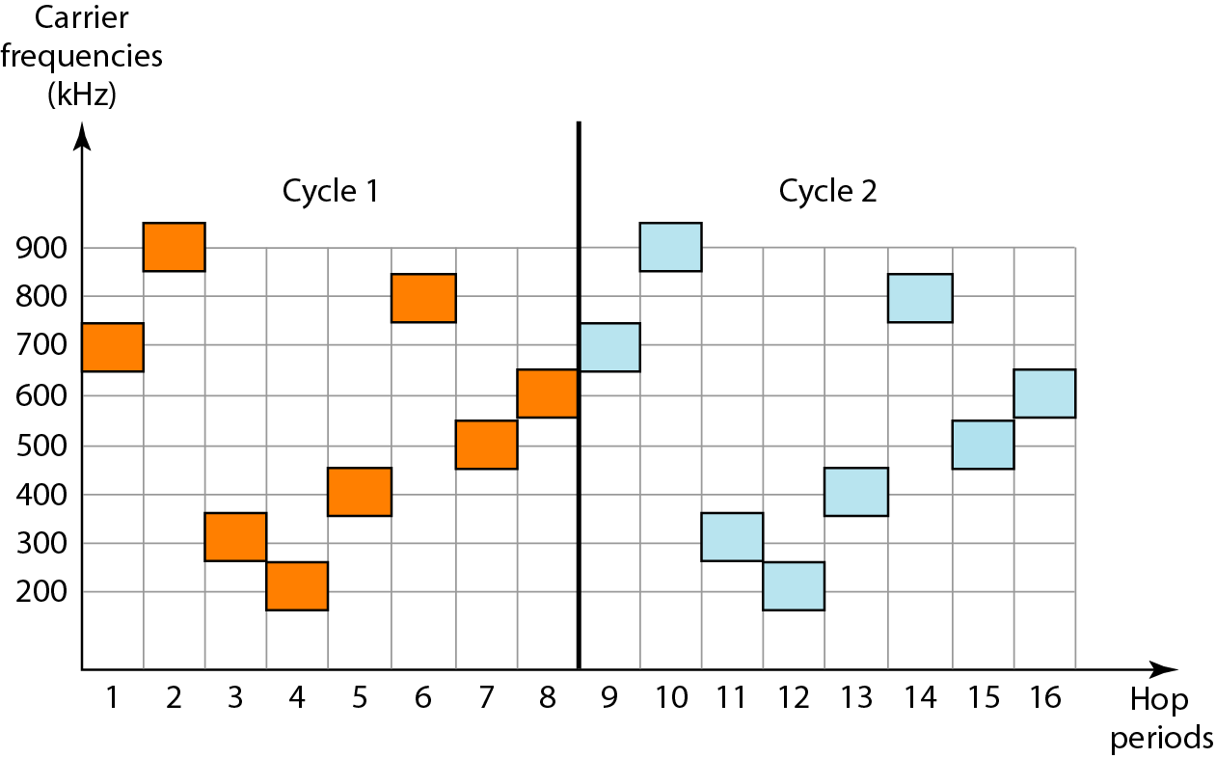
Figure 6.30 FHSS cycles

Slide 40
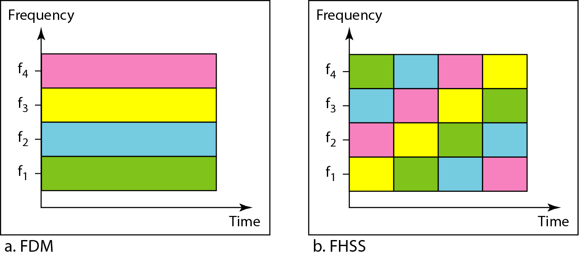
Figure 6.31 Bandwidth sharing
ch4
ch3
ch2
ch1

Slide 41
DSSS (Direct Sequence Spread Spectrum)
XOR of the signal with pseudo-random number (chipping sequence).
many chips per bit (e.g., 128) result in higher bandwidth of the signal

Slide 42
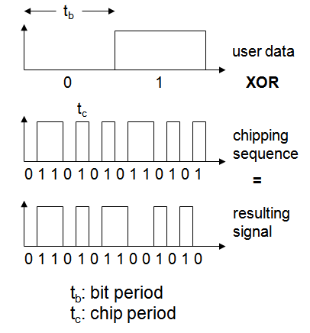
DSSS (Direct Sequence Spread Spectrum

Slide 43
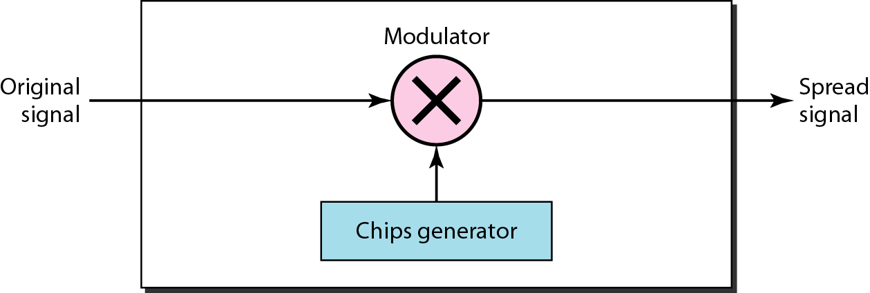
Figure 6.32 DSSS

Slide 44
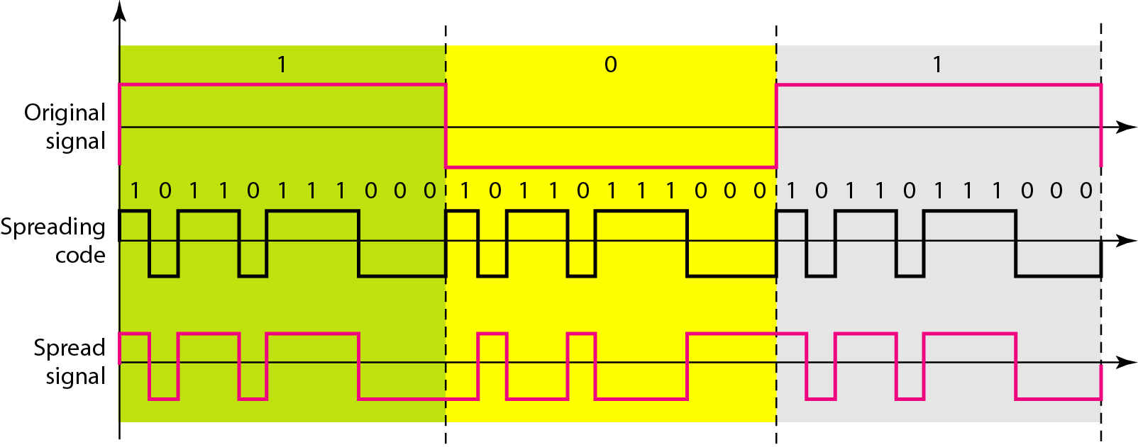
Figure 6.33 DSSS example

Slide 45
What have we completed?
Thank You
Multiplexing
Frequency Division Multiplexing (FDM)
Wave Division Multiplexing (WDM)
Time Division Multiplexing (TDM)

